Slide 1
Find Missing Children
By
Rohit Das - 61047086s
Judith Lin - 80747003S
黃意婷 - 61047024S

Slide 2
Can we find missing children using machine learning?

Slide 3
The Experiment

Slide 4
ChildGAN: Face Aging and Rejuvenation to Find Missing Children
Praveen Kumar Chandaliya, Neeta Nain
Malaviya National Institute of Technology Jaipur, India
https://doi.org/10.1016/j.patcog.2022.108761

Slide 5
Content
Introduction
Architecture
Loss Function
Dataset
Evaluation
Conclusion

Slide 6
Introduction

Slide 7
Introduction
According to a global report on human trafficking, most trafficking victims are women and children.
The National Center for Missing and Exploited Children (NCMEC) reported that approximately 800,000 children disappear in the USA every year.

Slide 8
Introduction
A large number of child trafficking victims are very young.
As time passes, their faces may appear to be quite different from the photos provided by their parents or relatives, and many times the face images are obstructed or blurry.
The face transfiguration makes it difficult to find the victims.
The work can help law-enforcement agencies to trace missing children.

Slide 9
Introduction
In this study, the proposed model is based on a variational auto-encoder (VAE) with a generative adversarial network (GAN) , which can simultaneously age and rejuvenate the face in the image space.
They conducted extensive experiments using ICD, with low-resolution faces and obstructions like caps or scarves, on images of real missing children.
They also investigate the generalization of ChildGAN using MRCD, on Asian, Black, White, and Indian race.

Slide 10
Architecture

Slide 11
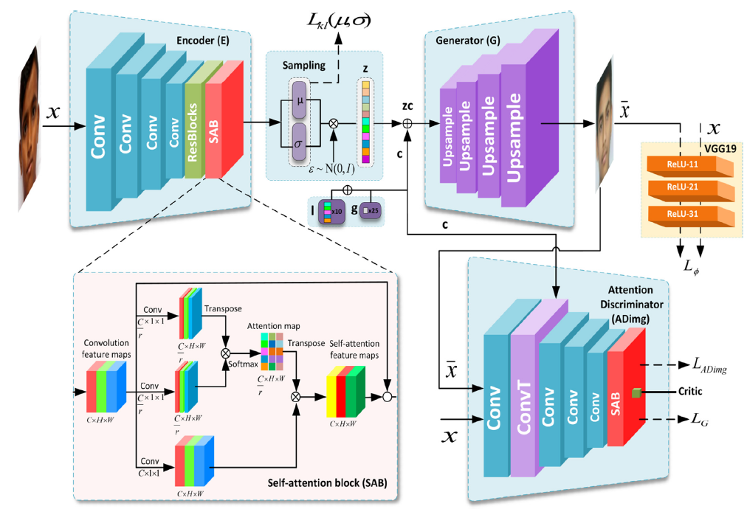
Architecture
Notes:
Encoder-Decoder-Generator 32,768 features
SAB- Self Attention Block - For generating features and keeping the utmost details
Compare the input image with the output image and using facial recognition

Slide 12
Architecture
Key Points:
Synthesize face (Encoder/Decoder)
Face Recognition (Discriminator)
Age based feature Recognition + Generation (Encoder/Decoder/Discriminator)

Slide 13
Loss Function

Slide 14
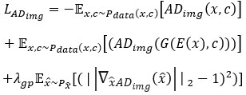
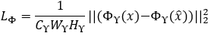
Loss Function
Adversarial Loss
Perceptual Loss
Notes:
Adversarial Loss - Double Bar E is euclidean space, x is input,c is concatenated conditional vector of age(L) and gender (G)
Lambda gp is the penalty co-efficient to penalize the gradients phi
Perceptual loss - To ensure Variational Auto Encoder(VAE)with its output and its corresponding input images has a similar deep features. Like clearer nose,lips and so on
C,w,h dimension of input image,phi is the feature map

Slide 15
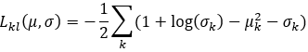
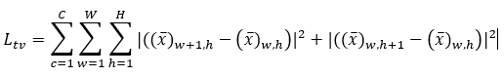
Loss Function
Kullback-Leibler Divergence Loss
Total variational Loss
Notes:
KL loss-One of the prime loss function in VAE(Variational Auto Encoder)
Regularizes Z vector(32,786 features vector) using reparameterization trick after normalization. For input image x the E network output the mean and covariance.
Total variation loss- Ensure measurable continuity and smoothness in the generated image to avoid noisy and over pixelated results. Sum of absolute difference for adjacent pixel values in the generated image.

Slide 16
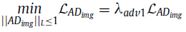
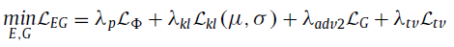
Loss Function
Full Objective Function
Notes:
Matching up all the equations
The goal of ChilDAN is to minimize the objective function for thee discriminator and Encoder as well as Generator
The L represents the set of 1-Lipschitz constraint

Slide 17
Dataset

Slide 18
Child Dataset - Indian Child Dataset (ICD)
35,484 child face images from 9,475 paired subjects and 7,494 not paired subjects.
54% boys and 46% girls
33,891 images are used in training divided into 5 overlapping age groups

Slide 19
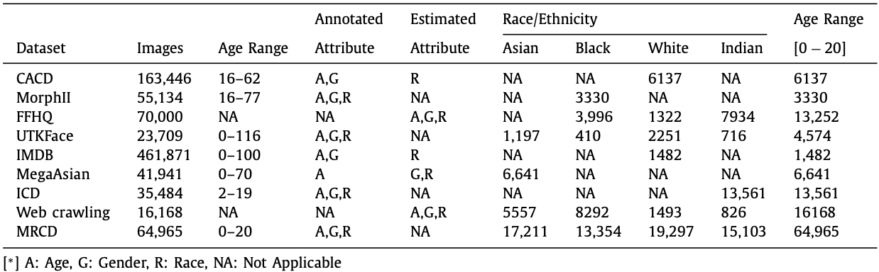
Multi-Racial Child Dataset (MRCD)
64,965 child face images consisting of 4 race groups
Selected from publicly available datasets and web crawling
Divided into 5 age groups

Slide 20
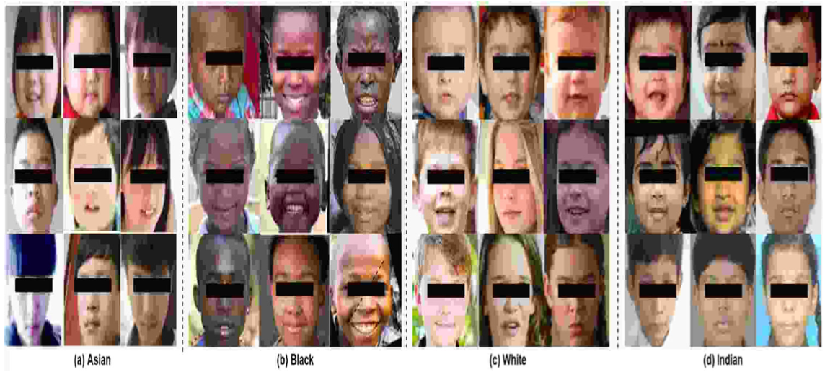
Multi-Racial Child Dataset (MRCD)

Slide 21
Multi-Racial Child Dataset (MRCD)
Race | Training | Testing | Total
Asian | 16,350 | 861 | 17,211
African | 12,686 | 668 | 13,354
Caucasian | 18,332 | 965 | 19,297
Indian | 14,348 | 755 | 15,103
Total | 61,716 | 3,249 | 64,965

Slide 22
Evaluation

Slide 23
Evaluation
Performance on low resolution faces
Performance on faces with obstructions
Performance on generalization

Slide 24
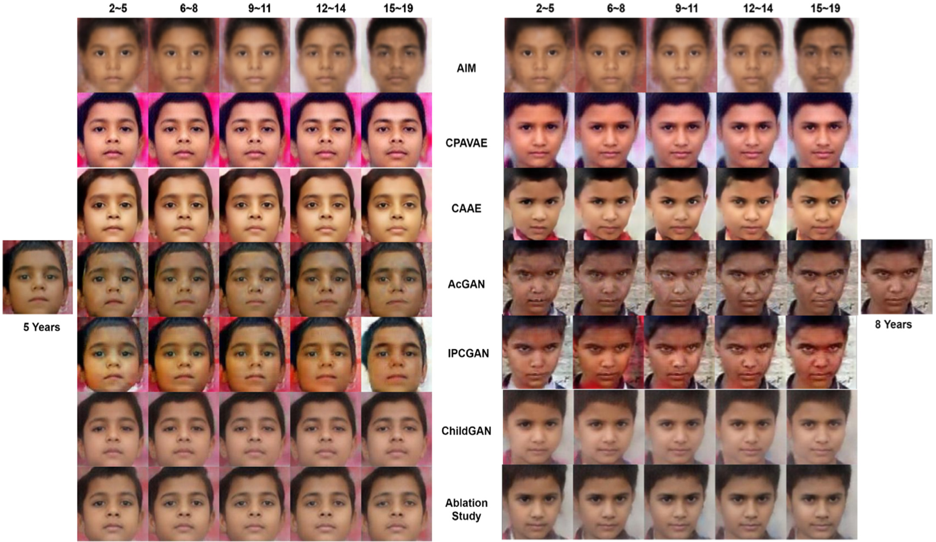
Evaluation on Low Resolution

Slide 25
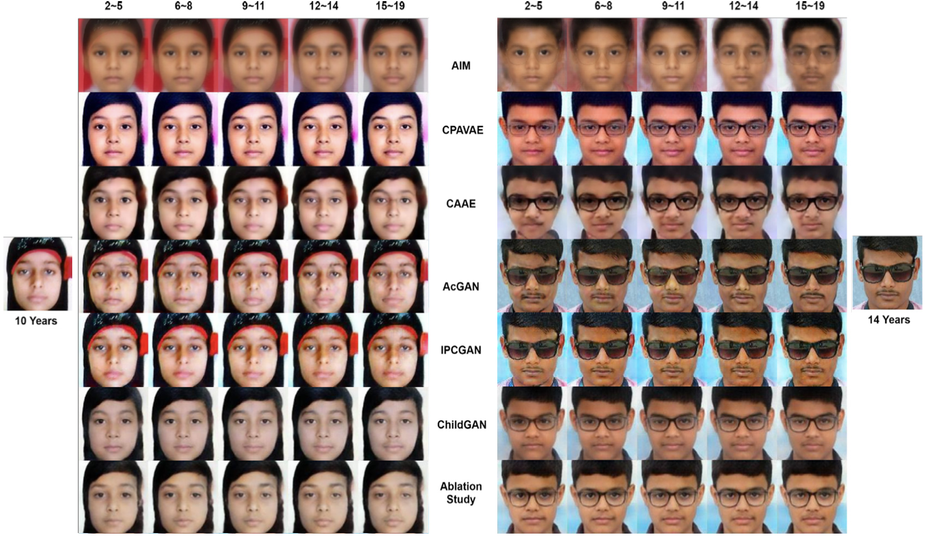
Evaluation on Faces with Obstructions

Slide 26
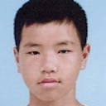
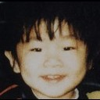

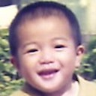
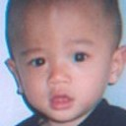

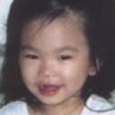
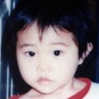
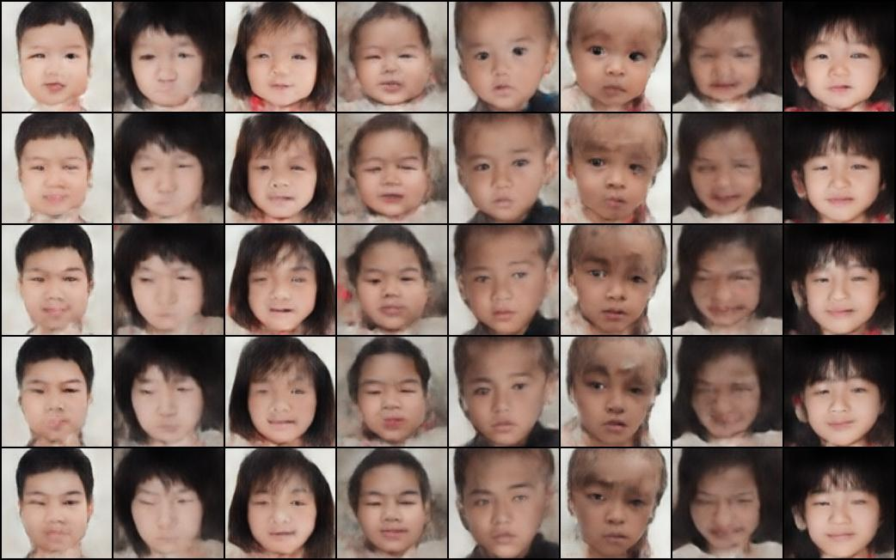
Generalization: Testing on Taiwanese Missing Children
14 y | 4 y | 1 y | 2 y | 2 y | 3 y | 3 y | 1 y
Input
0-3 years
4-8 years
9-12 years
13-16 years
17-20 years

Slide 27
Conclusion

Slide 28
Conclusion
Applications : border control, passport verification, access control, forensic science, and underage driver’s licenses.
ChildGAN demonstrates adaptation to a wide range of ethnicities and preserving the distinctive characteristics of each race.

Slide 29
Conclusion
IPCGAN, ACGAN, ChildGAN models, along with the ICD and MRCD datasets, make a significant contribution to society by reuniting missing children with their loved ones.

Slide 30
Thank You

Slide 31
Failed Experiments

Slide 32
Batch Size-16 Epoch- 24000

Slide 33
Batch Size- 16 Epoch-60000

